Slide 1
Pop Quiz:
Can you burst a balloon without touching it?

Slide 2
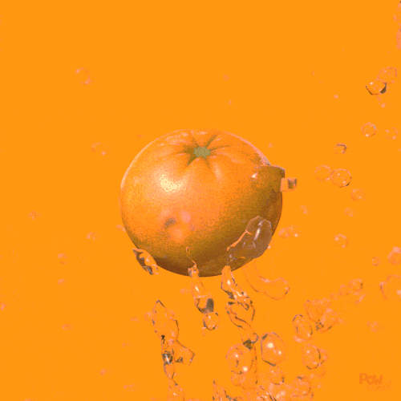
Orange Peel and Exploding Balloon Experiment
By Haoyun and Ethan

Slide 3
Hypothesis

Slide 4
Hypothesis support
Variables that may affect the outcome of the experiment:
Type of citrus fruit (orange, lemons)
Type of balloon used (water balloons vs normal balloons)
Amount of air/inflation in balloon
I think the balloon will have no reaction because…
When water is poured on the balloon, the balloon doesn't explode.
So why should it explode now?

Slide 5
The Experiment

Slide 6
Materials
Orange Peels
Balloons
Balloon pump
Found around the house!

Slide 7
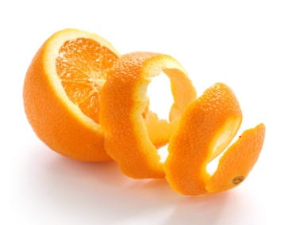
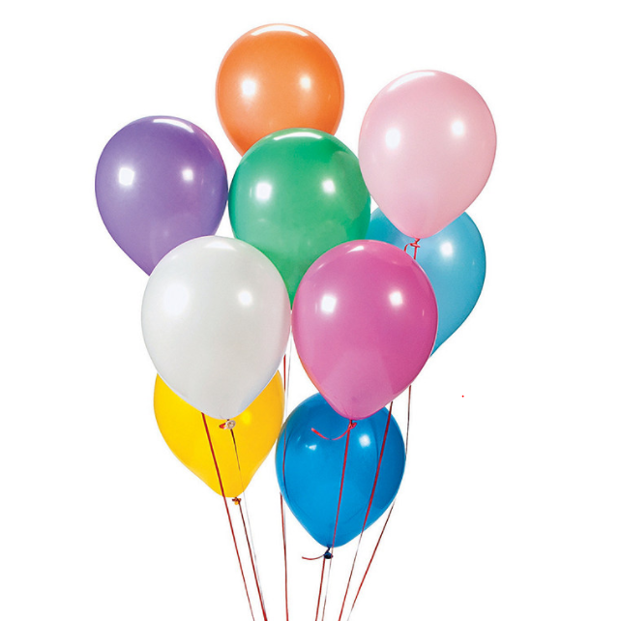
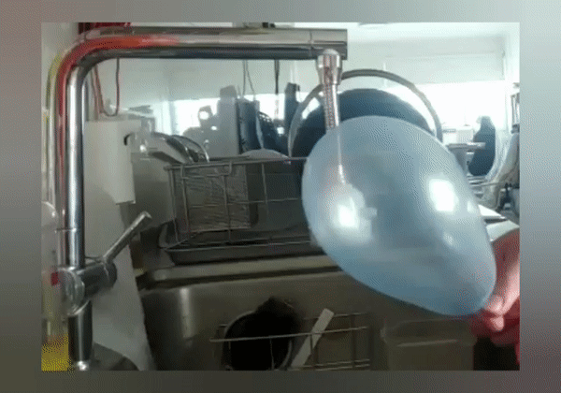
Procedure
Peel some orange skins.
Inflate some balloons.
Squeeze the orange peels onto the balloons
Boom!

Slide 8
Explanation

Slide 9
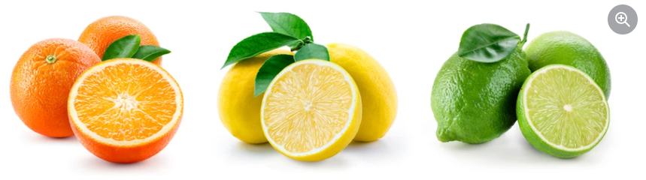
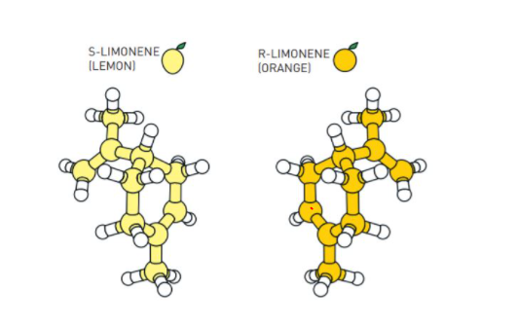
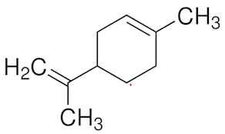
Where is Limonene found?
97% of an orange peel’s essential oil is limonene.
Limonene molecular structure:
There is a chemical in citrus fruits called limonene, which is a hydrocarbon.
A hydrocarbon is any of a class of organic chemicals made up of only the elements carbon (C) and hydrogen (H).
Latex rubber, which most balloons are made up of, is also a hydrocarbon. Hydrocarbons will dissolve together if they come in contact with each other.
So when the citrus oil touches the surface of the balloon, some of the latex from the balloon immediately begins to dissolve in the limonene and the balloon explodes.
Source: https://www.chemedx.org/blog/how-does-orange-peel-pop-balloon-chemistry-course

Slide 10
The End

